Slide 1
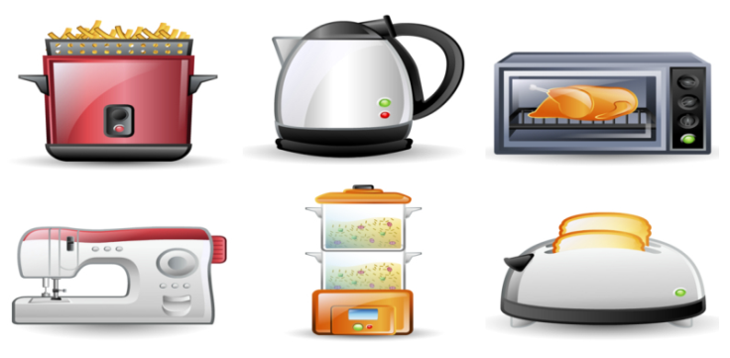
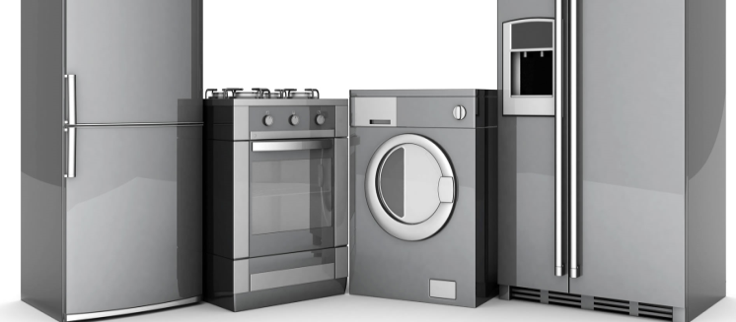
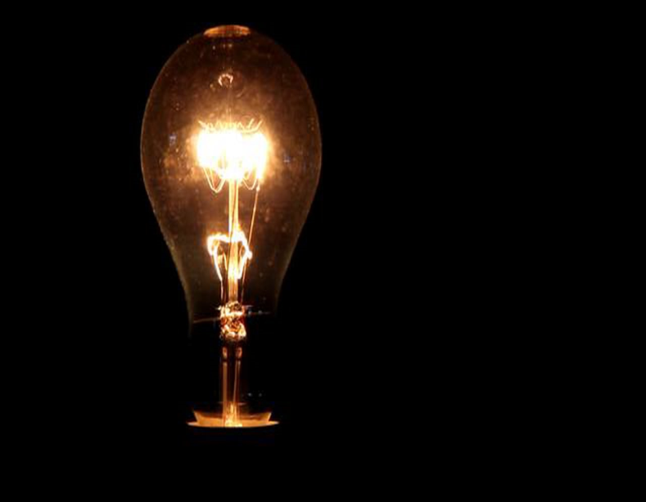
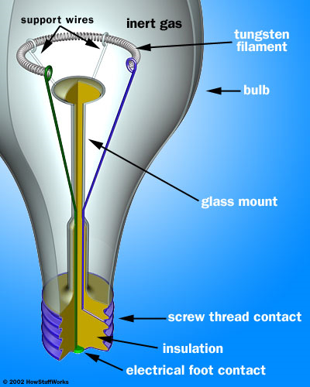
APPLIANCES
Resistors are poor conductors that force electrons to use more energy to move through them. We can use that energy as follows:
Bulb filaments (Tungsten) are resistors that produce light.
Nichrome is commonly used in resistors for toasters, heaters, stoves.

Slide 2
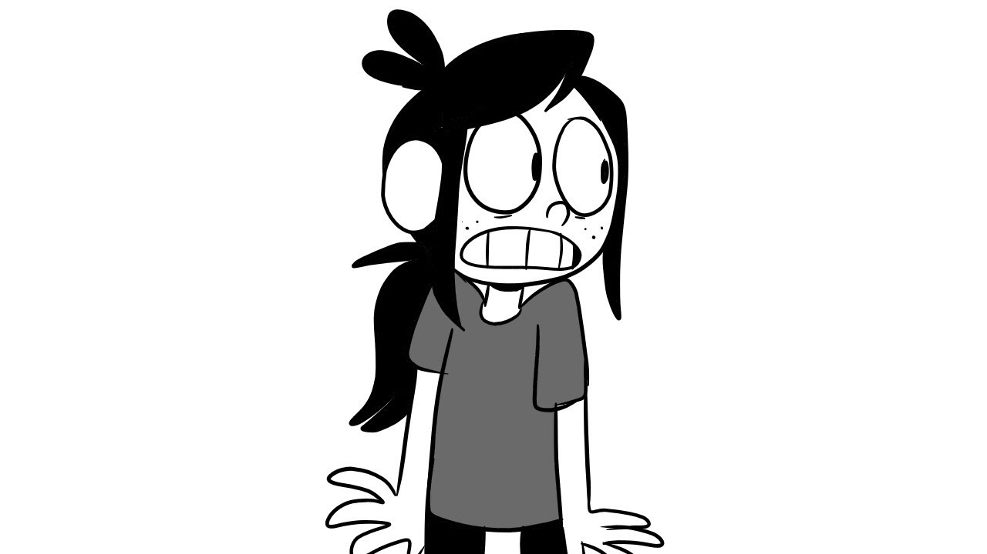
POSSIBLE PROBLEMS – Pg. 36-37
Short Circuit – The electrons move along a pathway that is different to where it should go – it takes a short-cut. This can result in over-heating, and a fire can break out.
Electrical Overload – when too many appliances are operating from one plug, you are using too much current, and can overheat.
Fuses – this is a little unit that has a thin piece of wire in it. If you overheat the circuit, this little wire melts, and stops the flow of electrons. Find the problem, fix it up, and put in a new fuse.
Circuit Breakers - this is a trip-switch that does the same job in your house, as would a fuse. Quicker than a fuse, more reliable, easier to switch back on.

Slide 3
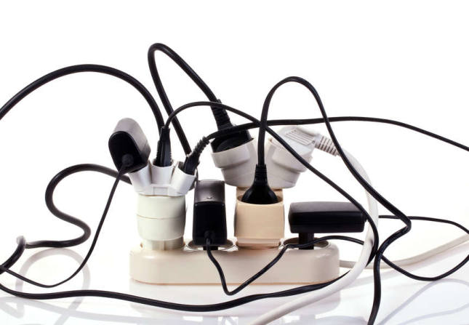
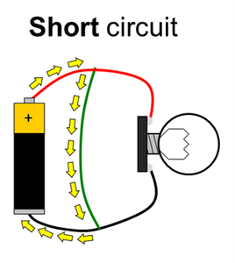
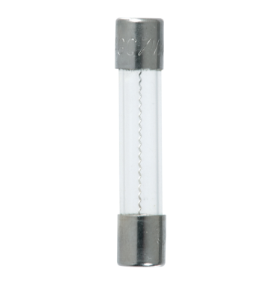
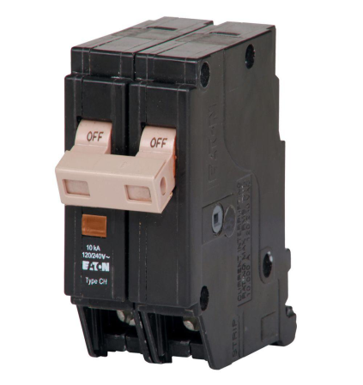
POSSIBLE PROBLEMS: PICTURES
SHORT CIRCUITS ELECTRICAL OVERLOAD
FUSES CIRCUIT BREAKERS

Slide 4
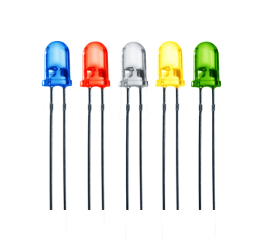
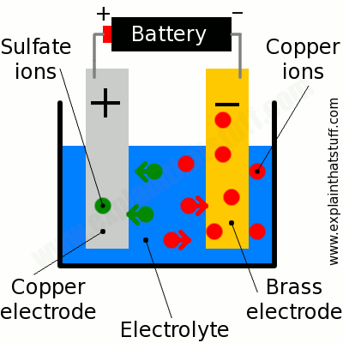
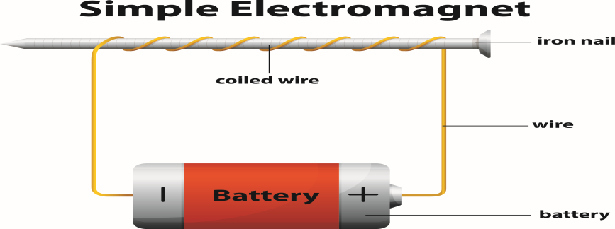
More Resistors, from Pages 37-39
Light Emitting Diodes (LEDs) produce light.
Movement results from fans, motors, micro-
waves.
- Heat in kettles, irons, heaters, stoves, toasters.
- Sound from buzzers, doorbells, radios, televisions.
ElectroPlating by ElectroLysis (see page 21).
- ElectroMagnet results from an electric current passing around a piece of iron.

Slide 5
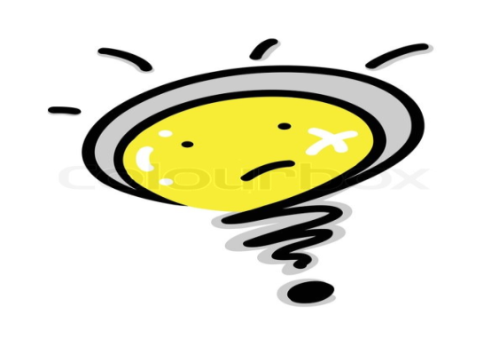
QUESTIONS Pages 89-90
Question 1
Electric charge flowing in conductor. [2]
(a) Electrons/Power (b) conduct [2]
Conductor allows charges to pass through it. Insulator does not. [4]
Symbols show what is in that circuit. [2]
Question 2 [16]
Component | Circuit Symbol | Function
 | ___________ | Conducts current.
Open switch | Given | Stops current from moving
 | ____.___.___ | Current can pass through.
Cell | Given | Produces electrical energy.
Battery
 |  | Electrical energy → light.
Fuse
Resistor

Slide 6
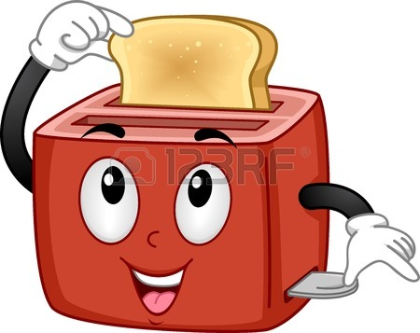
Question 3
Slows down electrical current to force extra energy. [2]
Light bulb. Kettle. Heater. Iron. Etc. [1]
(a) Heading: Light Bulb Filament
Electrical contacts Insulator [4]
(b) Tungsten: Resists electrical flow & has high melting point. [5]
(c) Argon [1]
(d) Filament heats up, becomes white-hot, produces light energy. [3]
Question 4
Smaller 2. Greater 3. Low 4. High [4]
Question 5
Good conductor, and relatively cheap. [2]
Nichrome. [2]
Electrical energy is turned into heat energy. [2]

